Slide 1

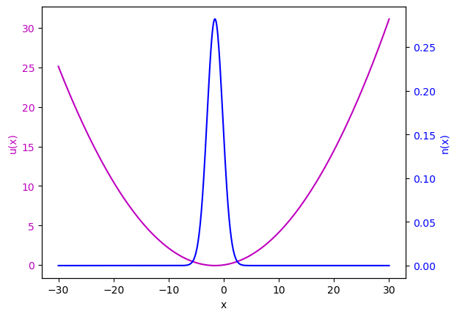
Automated numerical tests for iDEA for a single particle time evolution
Jamie Edwards

Slide 2

Introduction
Aims
Prove correlation by iDEA to the analytical solution for a single particle time evolution.
Make tests to show potential updates in the code continue to correlate.
Automate those test’s for push requests on GitHub.

Slide 3
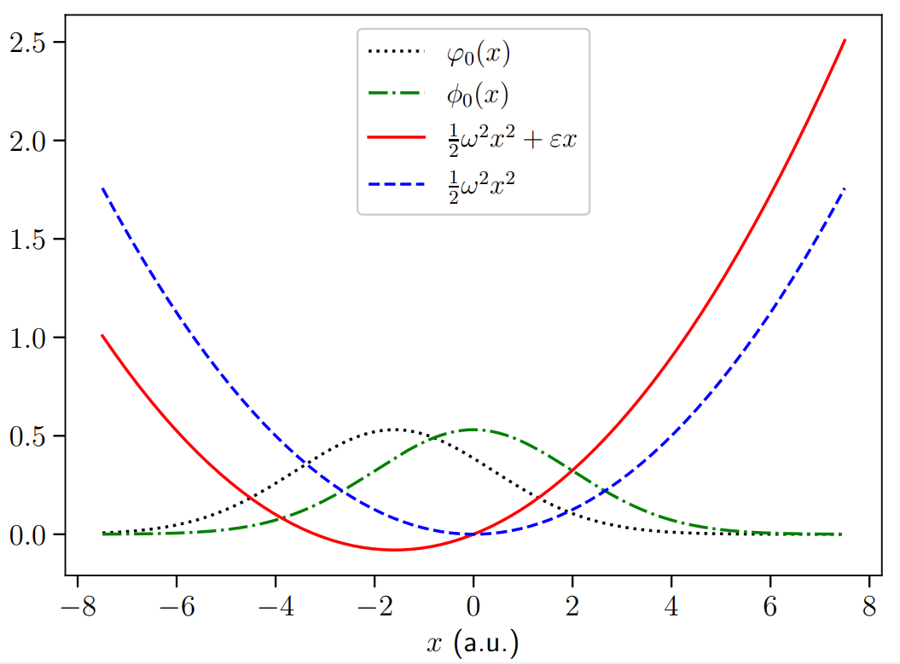

The system and its Analytic Solution
System
Quantum Harmonic Oscillator
Notes:
Time dependence from difference in field t = 0, t > 0
Occurs due to application of perturbating field -ex
Red line potential at t = 0, blue is potential after applied

Slide 4
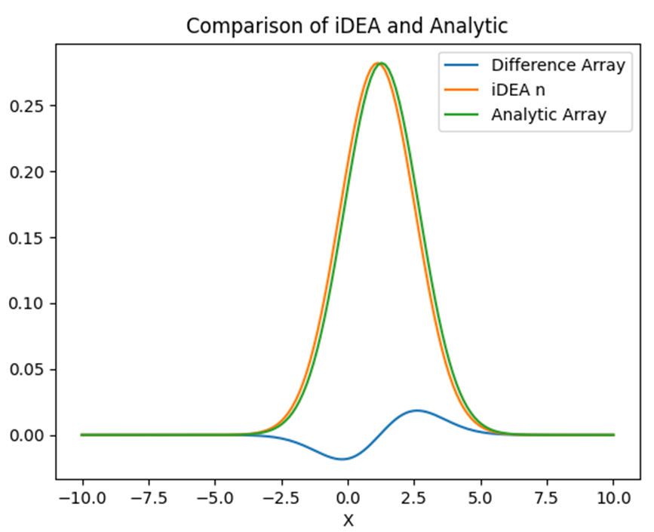
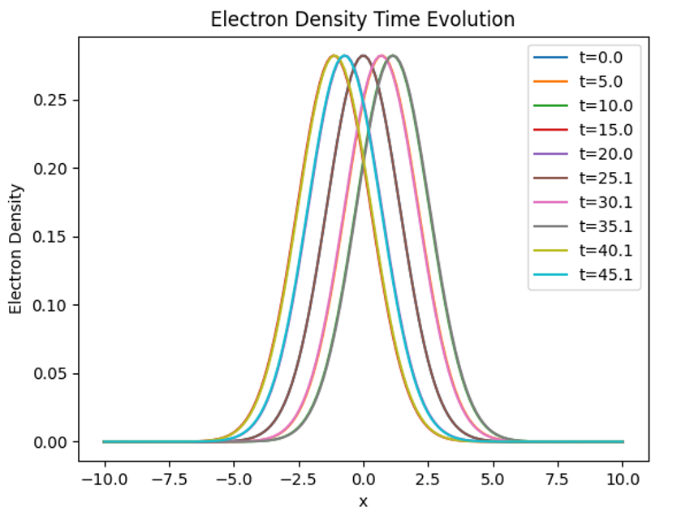
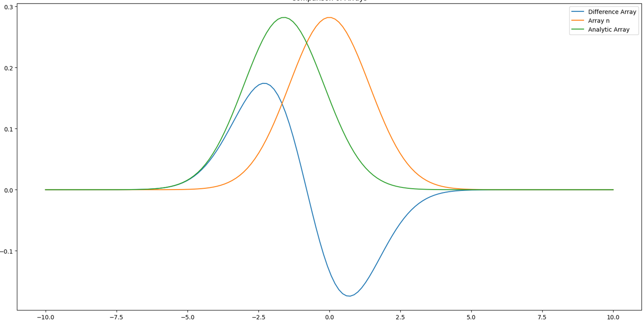
Initial Investigations
Both evolving as expected for a QHO
Density functions are out of phase
Notes:
Evolving as expected when viewed independently - oscillating
Densities are out of phase

Slide 5
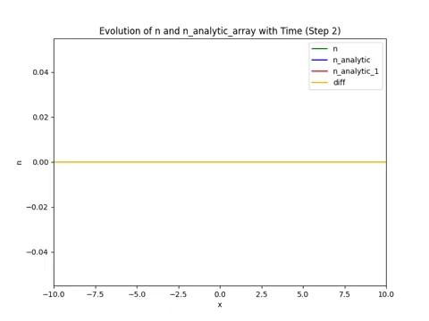
Initial investigations - Difference
Periodic nature due to becoming aligned at turning points
Magnitude of difference increases with time - accumulation of error
iDEA leading analytical solution
At t = 0 has acceptable error
Evolution of difference between iDEA and analytical solution. Calculated as n_iDEA - n_anlytical
Notes:
I care about the correlation between iDEA and analytical - difference
Periodic nature - aligned when happened to pass over at turning points
Increasing in magnitude - errors accumulating
iDEA - analytical : iDEA is leading
t=0 acceptable error rapidly increases some sort of time problem

Slide 6
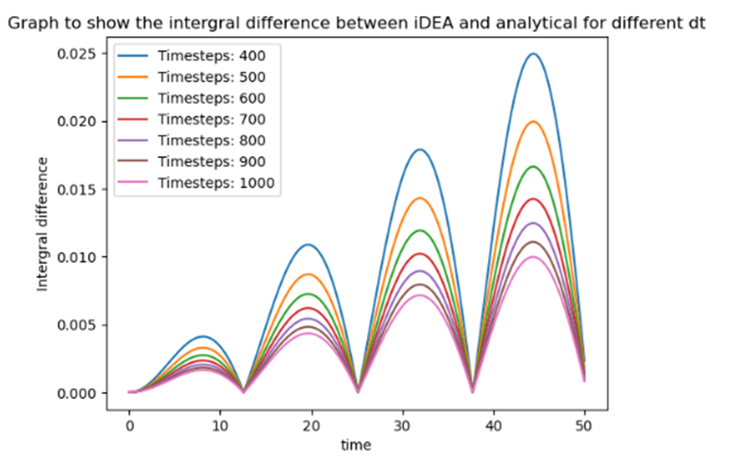
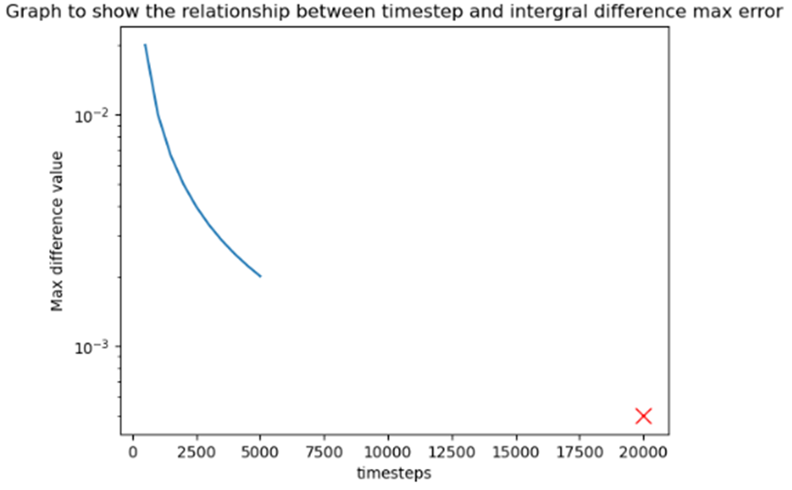
Potential source of error - dt
Reduction in dt does lead to a small reduction in error
Not significant enough reduction to be primary source of error
Notes:
dt = time / timesteps
Not going to reduce enough to get to precision we need

Slide 7
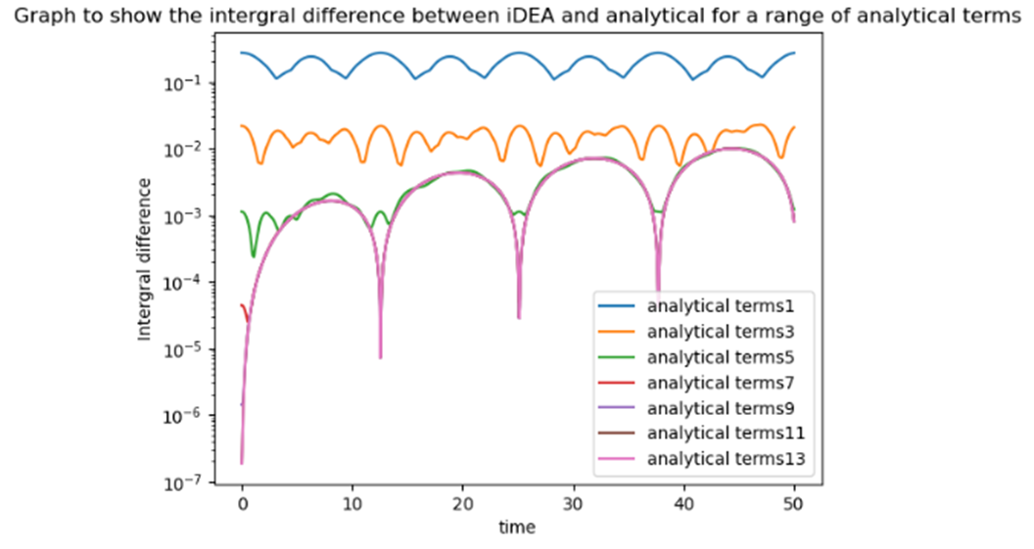
Convergence in analytical terms
Using 15 analytical terms from the start
Converged beyond roughly 10 terms
Periodic nature still visible in difference for high term solutions
Notes:
Converged
Incidentally you can see the rapid increase away from 0
Summation - infinite

Slide 8
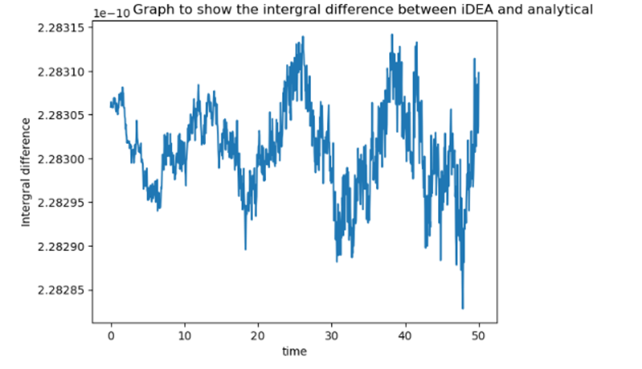
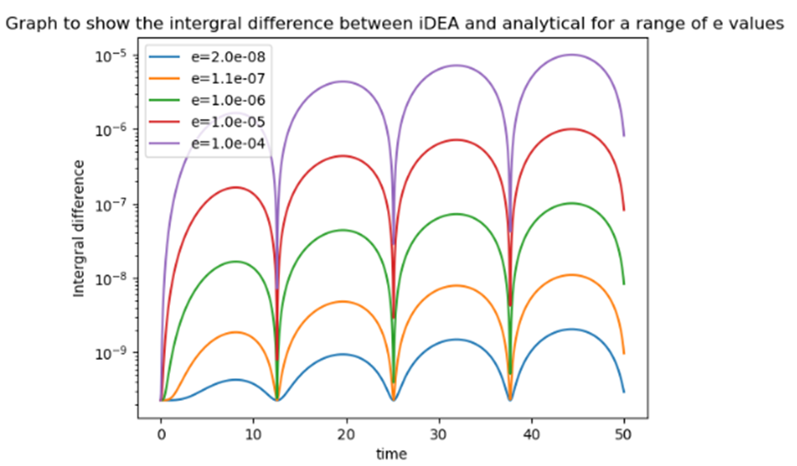
Perturbed field potential errors
Increase in difference potentially due to different fields in iDEA and analytical.
Variance of only 3e-14 - machine precision
Rapid increase in error when field reapplied
Notes:
When no perturbed field applied there is no time evolution - suggests error is in time evolution
Rapid increase in the field reapplied further suggests there is an error in the evolution

Slide 9
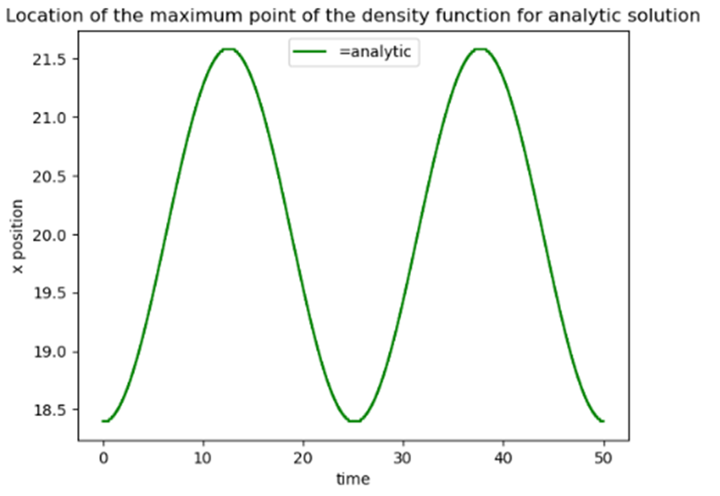
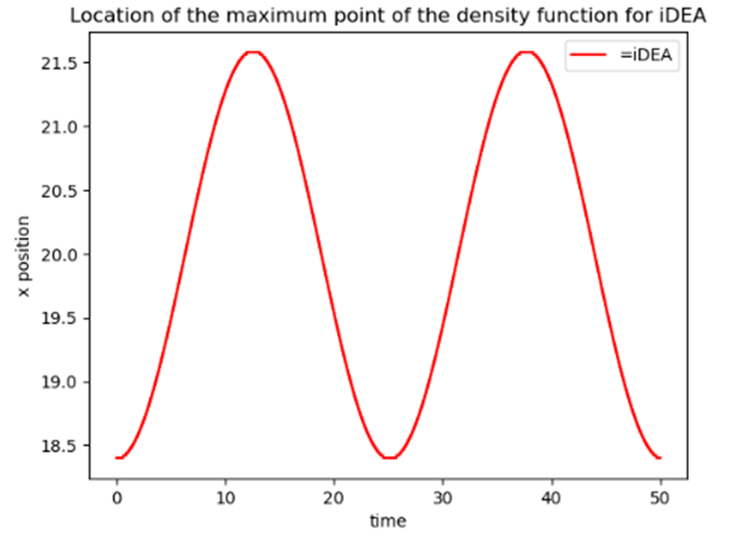
Peak position analysis
Analysing peak position only
Well defined point on the function
Sinusoidal movement in this point
Notes:
Decided to analyse the peak position to try and gain an understanding after exhausting all of the ‘obvios answers’
Well defined point - if we assume both are calculating n correctly and its a phase problem
Can see sinusoidal movement - as expected
X position is on y axis - would swap axis in future to make more

Slide 10
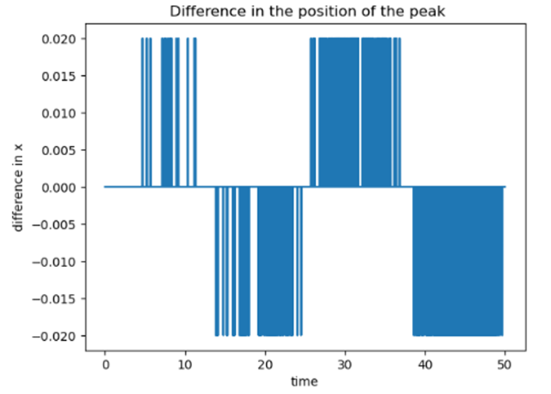
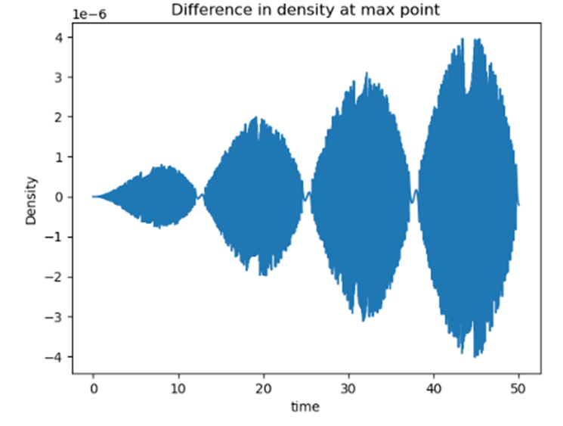
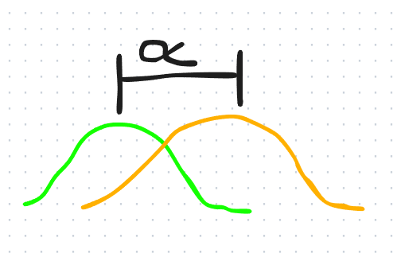
Peak position analysis
iDEA leading analytical
Small t sometimes on same step
Large t always 1 in front accumulation of errors?
Periodicity related to time period
Difference generally increasing with time
Difference between x position of maximum point of iDEA and analytical
Difference in calculated density at maximum point between iDEA and analytical
Notes:
Continuing to look at the peak position left hand plot is showing the difference in the x position - shown by alpha
Can see iDEA is leading analytical moves to the right to start
Sise of difference is exactly related to sise of dx
Accumulation of errors - always one in front by end not at start
Look at right hand side - again relationship to time period low difference at or around turning points
Can see its generally increasing, peaks of each domes looks linear - suggesting accumulation of error

Slide 11


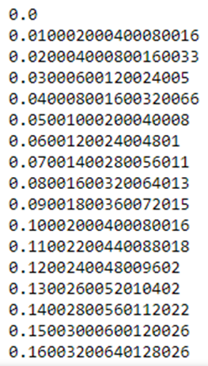

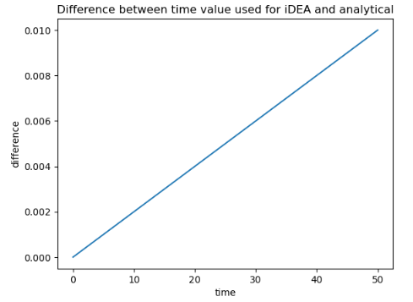

Floating point precision
By declaring the array for iDEA as an np.linspace array not exact values - created by a division.
Analytical solution using exact values - created by a multiplication.
Fix
Notes:
Not exactly the same value for t
Plot shows difference between values of t used
Makes sense with the results I had already found
I found good correlation at t = 0 - can see same for t = 0
Explains accumulation of errors - can see difference increases linearly which explains the previous page plot
Pretty confident this is the error

Slide 12
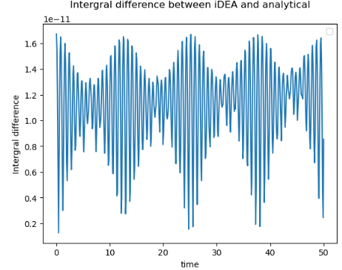
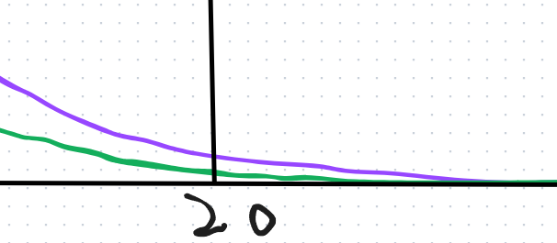
iDEA analytical alignment
Error dropped by 8 orders of magnitude, now at acceptable level of precision.
Periodicity still visible, although in an inverted way to previously.
Maximum difference at turning points, minimum while in center.
Oscillation of error with each timestep.
Notes:
Drops by 8 orders of magnitude
Inverted periodicity - max difference at turning points minimum in center
Oscillation - not insignificant amount - why?

Slide 13
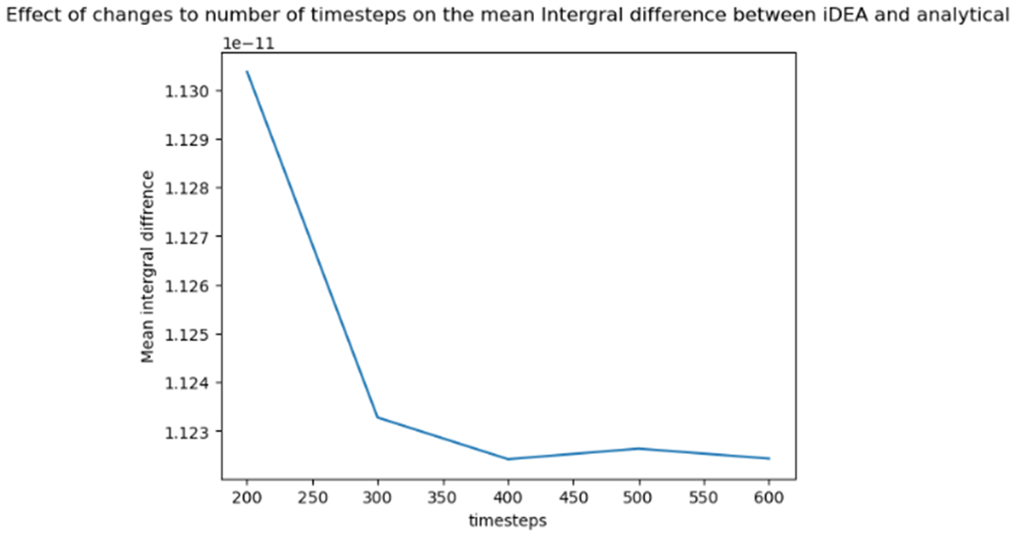
Convergence of solution in time
Converged beyond dt = 0.1
Limited gains between
dt = 0.2 and 0.4
Potential to increase dt to reduce runtime
Notes:
We see convergence in the difference in t
Happens at a point that is acceptable runtime to use

Slide 14
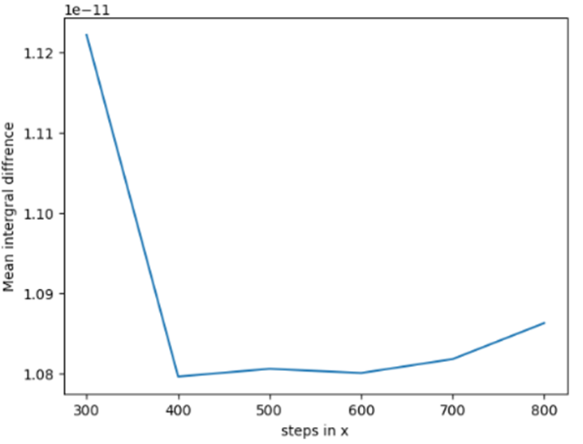
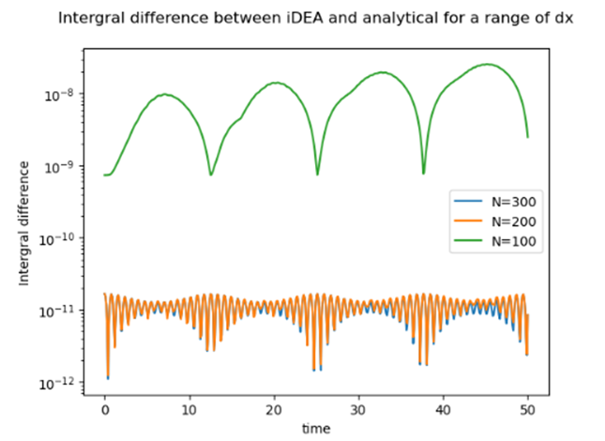
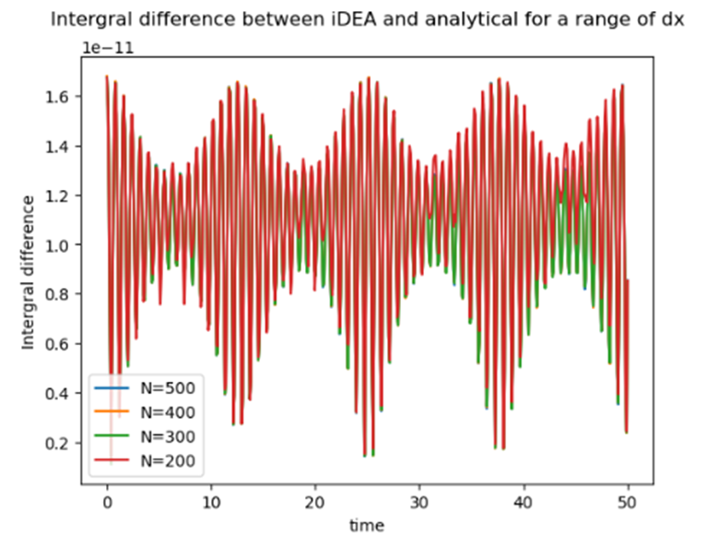
Convergence of solution in x
Effect of changes to number of steps in x on mean integral difference between iDEA and analytical
Initially appears converged for N>400 (dx < 0.1)
Further investigation appears error gets worse for smaller dx < 0.0666
Notes:
I haven’t had the opportunity to investigate this any further
Next week unless anyone has any thoughts on it now

Slide 15
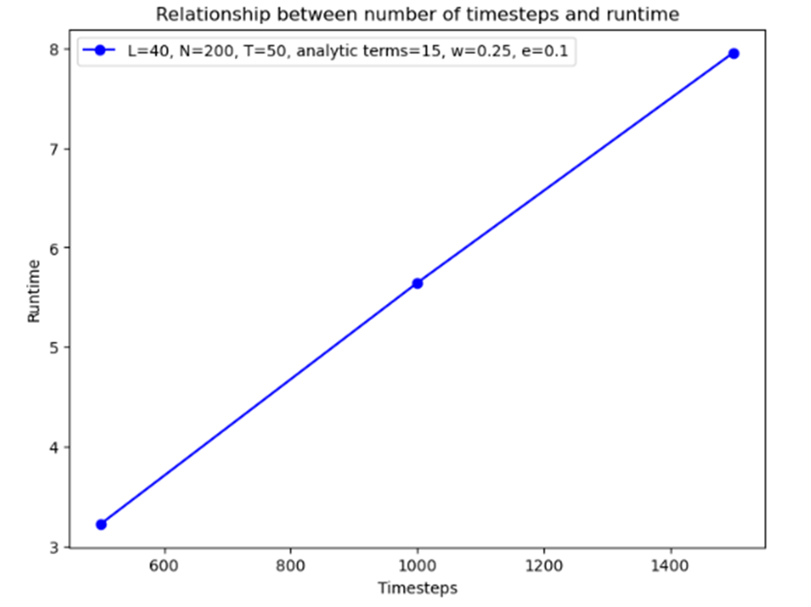
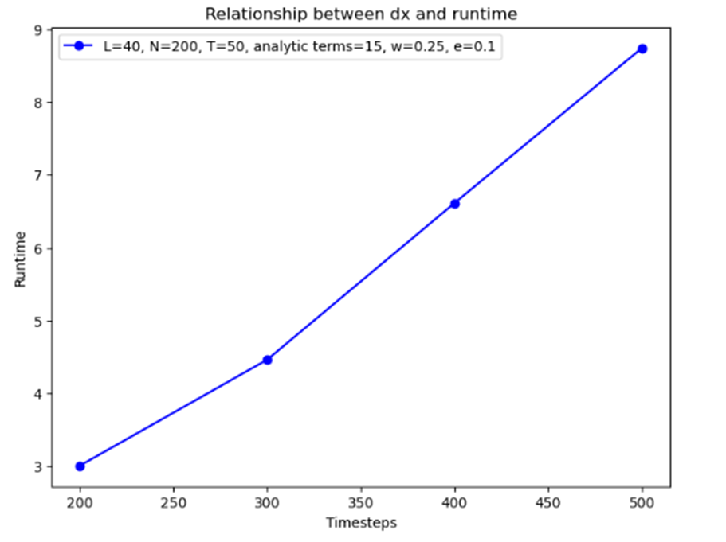
Effect on runtime
Both display linear relationships with number of steps and runtime
Runtimes at acceptable levels for test for converged solution dt and dx = 0.1
Plot showing the relationship between timesteps and runtime for dx = 0.1
Plot showing the relationship between steps in x and runtime, for dt = 0.1
Notes:
Done a quick check on the effect of changes to number of steps in x and t
Expecting a linear relationship what we get - each calculation is roughly taking the same amount of time
More calculations = more time

Slide 16
To conclude
iDEA correlates to within at least 2e-11 to the analytical solution for a single particle time evolution in a QHO potential.
iDEA is converged for dt < 0.1
Linear correlation between number of steps in x and t and runtime

Slide 17
Next steps
Investigate increase in error for dx <0.0667.
Change size of system and potential to investigate suspected edge effects.
Investigate origin of oscillation with each timestep.
Investigate changing dt and dx simultaneously to find best solution and then produce 2d heat plot.
Decide on tests and acceptable limits and then automate them for GitHub push requests.
Notes:
Parde approx

Slide 18
Appendix

